Slide 1

DSP PROJECT ON DRIVER TELEMATICS
Data Science Group Project
Team Members
Prithvi Kocherla (#U50193006)
Ramreddy Duddela (#U62350397)

Slide 2
INTRODUCTION:
In contemporary world, tracking of vehicles is possible through GPS sensors and storage of this data could lead to obtain deep insights of information that contains.
This data can be used to identify the driving patterns and compare among individuals.
This can be used by insurance firms and can benefit good customers by providing them with low premium rates, replacing the old conventional type of premium rates that are decided based on number of previous accidents or number of tickets incurred to an individual or vehicle characteristics.

Slide 3
OBJECTIVE OF OUR STUDY:
Analysing the features derived from driving patterns of various trips and relatively grouping them based on risk levels possible.
Predicting the category of new trips into one of the risk levels.
Idea here is to make this concept for insurance companies to identify good drivers and reward its customers with low premium rates.
This internally promotes individuals to drive safe with the statistics displayed.

Slide 4
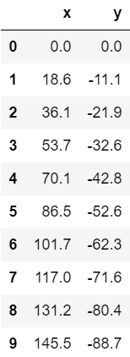
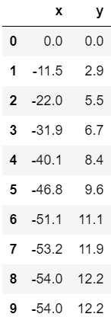
DATA EXPLORATION:
The data shown here is real time observed cleaned data for 2 out of 200 trips.
The columns here represent X and Y co-ordinate positions.
For drivers identity protection, the co-ordinate values are shifted to origin on graph plot.
These X,Y values are obtained through sensors attached to vehicles and recorded for every 1 second.
Source – Kaggle competition, sponsored by AXA insurance company.
Next is to explore the features existing with these datasets.

Slide 5
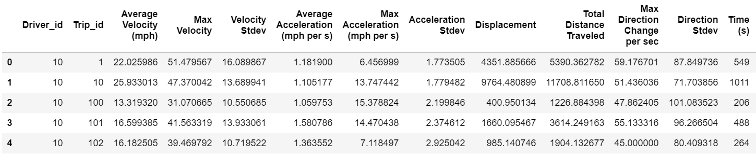
DATA EXPLORATION:
Our reference dataset, consisting of various inter-related features, that are developed from base data.
Total of 17 features are available to dig insights.
These are grouped by Driver ID’s & tagged with corresponding Trip ID values.
Features:
Avg Velocity
Max Velocity
Velocity Stdev
Avg Acceleration
Max Acceleration
Acceleration Stdev
Displacement
Total Distance
Direction Change
Direction Stdev
Time
Turns
Aggressive Turns
Stops
Deceleration
N/ of Decelerations
Max Deceleration

Slide 6
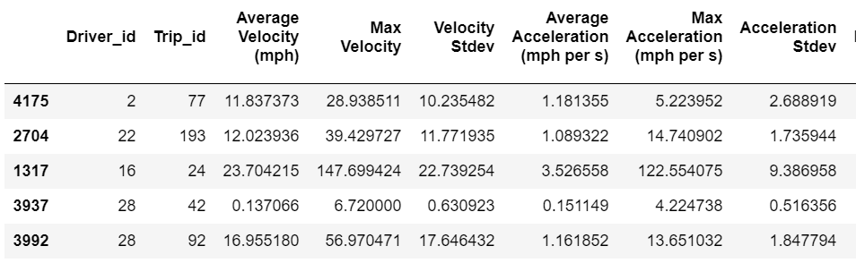
DATA PRE-PROCESSING:
Entire dataset is grouped by Driver ID’s,
- For better results data is shuffled and that data is used for training.
For clustering, the columns, Driver ID & Trip ID have no scope,
- Hence, these are completely removed from our analysis.
Null values are identified to be existing,
- Those values are replaced by Mean of that respective features.

Slide 7
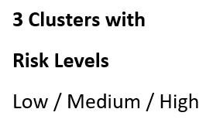
ANALYSIS:
K-Means Clustering:
Since, data here has no column dedicated as output, this falls under un-supervised learning.
This required us to group the data into certain clusters based on rules.
K-Means is a method of vector quantization, in which each observation belongs to a cluster with nearest mean.
Number of clusters considered are 3, with an idea to label each drivers risk level to be either Low/ Medium/ High.

Slide 8
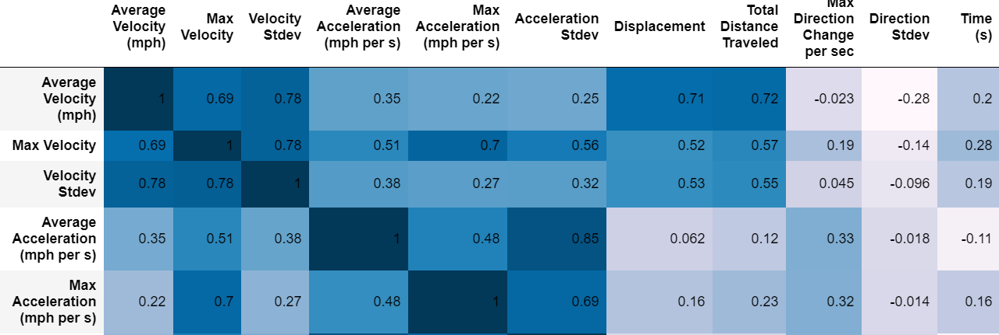
ANALYSIS:
Correlation among Features:
By using K-Means, we get the data divided into clusters.
As there are numerous features existing, it is important to evaluate correlation among features to formulate base decisions.

Slide 9
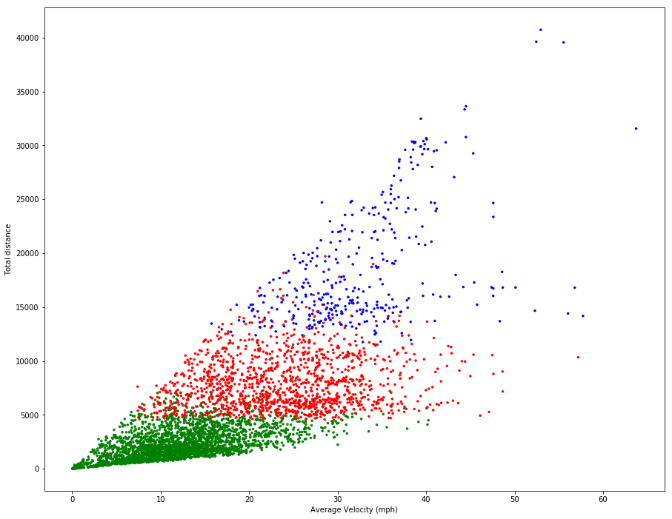
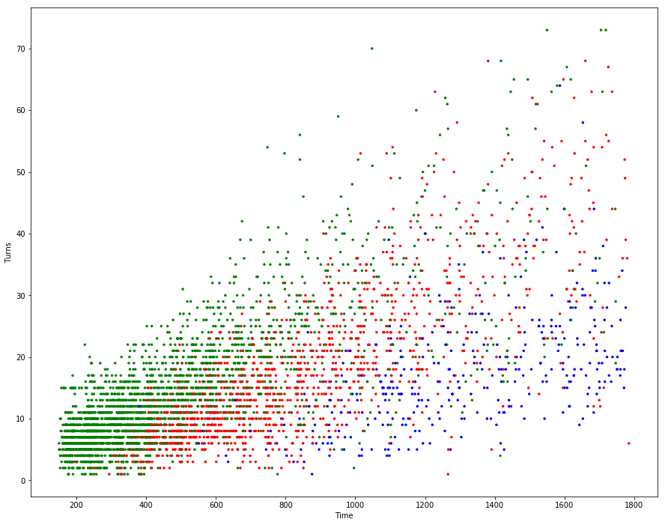
VISUALIZATIONS:
Based on correlation values, scatter plots are drawn to visualize clusters.
Below shown clusters are for (Avg. Velocity vs Total Distance) & (Time vs Turns).

Slide 10
DATA MODELLING:
K-Means Clustering:
Since, data here has no column dedicated as output, this falls under un-supervised learning.
This required us to group the data into certain clusters based on rules.
K-Means is a method of vector quantization, in which each observation belongs to a cluster with nearest mean.
Number of clusters considered are 3, with an idea to label each drivers risk level to be either Low/ Medium/ High.

Slide 11
DATA MODELLING:
Decision Tree Classifier:
As the data here contains many features, grouping decisions have to be made by identifying the key features.
Decision Tree builds classification in the form of tree like structure, with Decision nodes and Leaf Nodes.
By fitting this classifier with 3 levels of decision nodes, we get the key feature on root node to be ‘Total Distance’.
Accuracy obtained – 96.08%

Slide 12
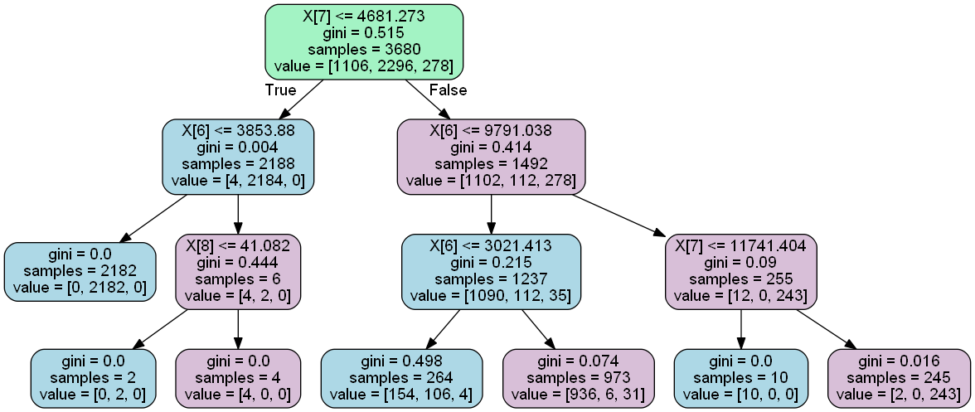
DATA MODELLING:
X[6] – Displacement, X[7] – Total Distance, X[8] – Max Direction Change/sec

Slide 13
DATA MODELLING:
Random Forest Classifier:
Instead of using 1 single decision tree, the idea here is to ensemble a group of decision trees built at the same time and allow the classifier to choose a class with high accuracy.
Advantage: This classifier has relatively less number of user defined parameters.
Theoretically, it is expected to produce increased accuracy in comparison to previous Decision Tree Classifier.
Accuracy obtained – 98.15%

Slide 14
DATA MODELLING:
Support Vector Classifier:
With the advantage of different kernel functions support and capability to perform multi-class prediction, SVC is used.
SVC linear and polynomial model is used.
“One vs Rest” phenomenon is used in both classifications.
Observations, the confusion matrix and accuracy obtained in both cases are same indicating no additional benefit by adding polynomial features.

Slide 15
OBSERVATIONS:
By evaluating three methods, relatively we obtain less accuracy for Decision Tree model.
The accuracy levels are comparatively matching for both Random Forest & SVC classifiers.
With the help of these models, we can now predict the driving style patterns, given the position of vehicle with respect to time.
It can now be considered by insurance companies in evaluating the premium price for their plans.
This particular concept is presently in use and a dedicated application is now available by name ‘DriveWell’, representing the research work done at Cambridge University.

Slide 16
REFERENCES:
Initial Dataset with features –
https://github.com/georgetown-analytics/skidmarks/blob/master/bin/lin.csv
Kaggle competition work –
http://nbviewer.jupyter.org/github/georgetown-analytics/skidmarks/tree/master/bin/
Decision Tree Example –
https://pythonprogramminglanguage.com/decision-tree-visual-example/
https://www.tandfonline.com/doi/abs/10.1080/01431160412331269698
https://www.saedsayad.com/decision_tree_reg.htm
THANK YOU!

